Slide 1
Data Visualization Project

Slide 2
Process Description:
In this project, I will explain the effect of covid-19 on the unemployment rate in our country. Many workplaces were closed due to Covid-19 and workers were removed from the workplace. Compared to previous years, unemployment increased significantly in the covid-19 period. I got some data about this from CDC numbers and DISK-AR sources. I will explain this data on the chart and transfer it to you.
For my project, I used government sources for all the data except the COVID-19 numbers. The data compiled in the Turkey seemed more complete as it was updated everyday, versus the CDC numbers and DİSK-AR which could only be updated for states that supplied the information to them.

Slide 3
Process Description:
Day by day I did my research for this topic, reviewed the data and prepared myself to prepare a report on this subject. At the moment, the unemployment issue related to the covid problem is more prominent and I have tried to present the resources I find without going beyond the unemployment issue.I started with COVID-19 data consisting of states, dates, number of cases, number of deaths, and state codes. I removed the state codes column because I considered it foreign information. I uploaded the data to GitHub. Over time, I examined and showed the number of cases and deaths by state. I wanted to investigate this data further because I had a lot of resources on this topic, so I created a calculated column showing the mortality rate by state (deaths divided by cases). I used several charts to size the cases by case count and color them by death rate. I wanted to see if this was related to the number of unemployment claims by the state. I downloaded unemployment data from the Department of Health and it seemed that jobless claims were actually higher in states that had more cases. I researched the population demographics of some states, their response to the pandemic, and the major industries that make up their economies. Then I drew my conclusions from the collected information.

Slide 4
I had a few problems finding data for my project.I had difficulty finding some of the data I wanted, because I think that due to privacy reasons, not all sites wanted to transfer the data as it is. I wanted to make sure that the data I presented was accurate, but also complete. Turkey seemed to have the most complete and up-to-date information on the COVID-19 cases and the number of deaths. The Department of Health and the News tried to show the jobless claims weekly. Unfortunately, they only have data on who applied, so it's not people who have lost their jobs, they may not have applied yet. It also does not distinguish between dismissal due to covid-19 and a seasonal worker who has been laid off or an employee who has been laid off.
The purpose of my presentation was the people of Turkey. The issues currently on everyone's mind are COVID-19 and the economy. I wanted to create a presentation that gave a brief analysis of what was going on, without any political or other bias – just facts. Hail to the health workers who are working to help people during this pandemic.

Slide 5
COVID-19 & Unemployment
After the epidemic started in Turkey, various measures came to the fore. The government did not accept a general quarantine and isolation proposal. Instead, partial quarantine and isolation measures were applied. First of all, schools and kindergartens were closed. Later, places where people gathered together (shopping mall, restaurant, cafe, etc.) were closed. Citizens over 65 and under 20 were banned from going out, and travel restrictions were imposed for those living in big cities. In addition, a curfew was imposed, usually on weekends and public holidays. These restrictions caused sluggishness in the economy and the unemployment rate increased day by day.

Slide 6
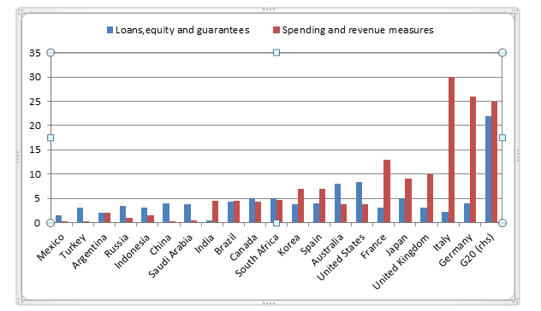
The government announced a package called the Economic Stability Shield against the effects of Covid-19 in March 2020. It was announced that the package, which was first 100 Billion TL (approximately 15 Billion US Dollars), was later increased by 250 Billion TL (36 Billion US Dollars). However, it was observed that most of this package was fictitious and consisted of loan facilities and deferrals. It is seen that the package of economic measures announced by the Government of Turkey ranks 2nd from the last among the G20 countries in terms of its ratio to GNP.

Slide 7
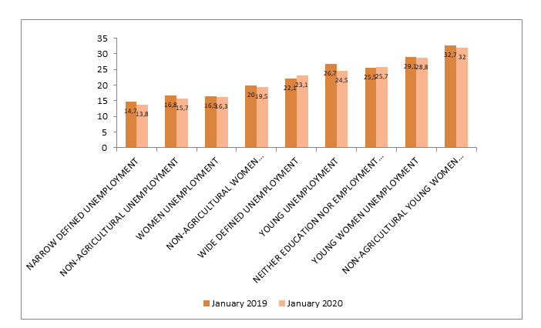
Young female unemployment and urban female unemployment continue to be seen as the highest type of unemployment in the last 1 year. In January 2020, the highest increase was seen in urban young female unemployment.
Unemployment of unemployed youth, which was not seasonally adjusted, decreased by 2.2 points to 24.5 percent in the last 1 year, and female unemployment that was not adjusted for seasonal effect decreased by 0.2 points to 16.3 percent.

Slide 8
During the crisis, urban young women unemployment reached 36 percent, saw the highest level of unemployment in the women's unemployment category. In January 2020, urban youth unemployment was again the highest type of unemployment.
There is a general decrease in unemployment types in January 2020 compared to January 2019, when the impact of the economic crisis was seen the most. However, the increase in the number of young people who are neither in education nor in employment (NEET) continues. In January 2020, the NEET rate increased by 0.2 points compared to January 2019 and reached 25.7 percent.

Slide 9
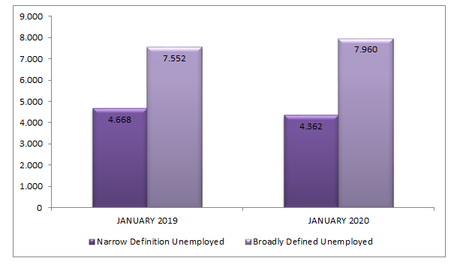
While the number of broadly defined unemployed people calculated by DİSK-AR was 7 million 552 thousand in January 2019, it reached 7 million 960 thousand people with an increase of 408 thousand in January 2020. Broaḑ defined unemployment rate was calculated as 23.1 percent in January 2020. While narrow unemployment is decreasing, one of the reasons for the increase in broad unemployment can be shown as the remarkable increase of those who are not looking for a job but are ready to work during the crisis period. The unemployed, who lost their hope as a result of long-term unemployment during the crisis period, increased by 53 percent in the last 1 year.

Slide 10
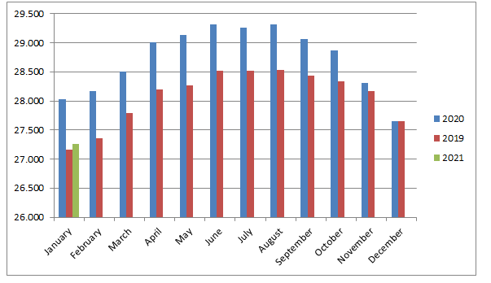
Unseasonably-adjusted employment, which was 28 million 29 thousand in January 2020, rose to 29 thousand 318 in August 2020, when the crisis started. Although the number of employed people, which showed a steady decrease from August 2020 to February 2019, showed an increasing trend in February 2019, it started to decrease again after July 2019. The number of people employed in January 2021 has decreased by 2 million 52 thousand to 27 million 266 thousand since August 2020, when the crisis started.

Slide 11
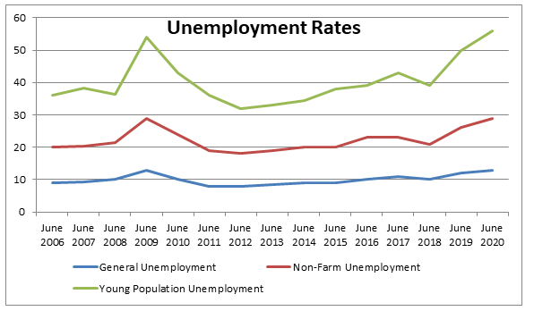
Unemployment levels in 3 different categories appear together with the figures. The table above examined the month of June. Unemployment levels from June 2006 to June 2008 follow each other. However, there is an increase in the unemployment level in June 2009. In the following years, the unemployment level both increased and decreased. In June 2019 and 2020, the unemployment level gradually increased due to the corona. The fastest increase is seen in these years.
COVID-19 does physically affect older people at a higher rate, but younger age groups feel the financial effects. The service sector has had to lay off a lot of people due to many businesses being considered non-essential, such as salons and clothing stores. About 40% of the service sector consists of people aged 16 to 24.They are the most affected.

